Slide 1

Another Gospel Is Not the Gospel
1:1 – 10
Week 2
26 January 2022

Slide 2

Another Gospel Is Not the Gospel

Slide 3
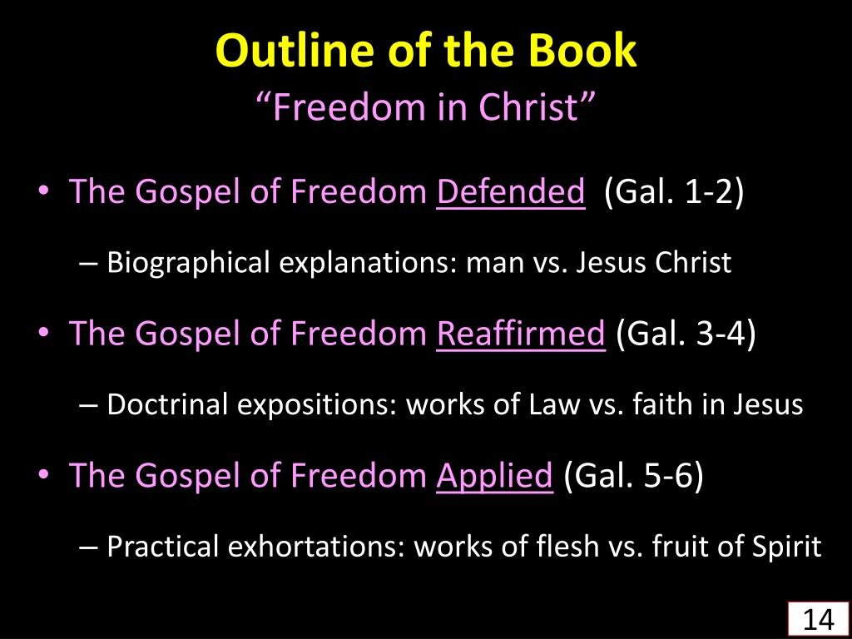

Slide 4
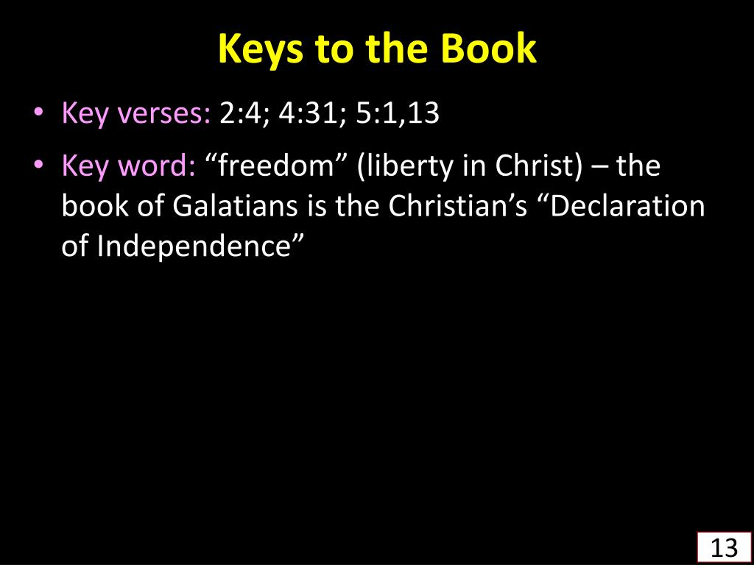
2:4 > “And this occurred because of false brethren secretly brought in (who came in by stealth to spy out our liberty which we have in Christ Jesus, that they might bring us into bondage).”
4:31 > “So then, brethren, we are not children of the bondwoman but of the free.”
5:1, 13 > “Standfast therefore in the liberty by which Christ has made us free, and do not be entangled again with a yoke of bondage . . . For you, brethren, have been called to liberty; only do not use liberty as an opportunity for the flesh, but through love serve one another.”

Slide 5
“The Magna Charta of Christians Liberty”

Slide 6
The term “Galatia” (1:2) can be understood in two different ways. One refers to the area inhabited by the Galatian ethnic group in northern Asia Minor—a place visited by Paul, if at all, on his second or third expeditions.
A second usage refers to a political division of central and southern Asia Minor that became part of the Roman Empire in 25 B.C.
Most scholars favor the view that this letter was addressed to the churches in the southern cities of this region—cities visited by Paul on his first and second missionary expeditions.

Slide 7
Another Gospel Is Not the Gospel

Slide 8

Galatians
Introduction:
Paul’s letter to the Galatians set us free. Its bold statement of liberation grace points us away from a false gospel of self-empowered works and toward the true gospel of faith and Spirit-empowered love. Its basic theme, to which we will return again and again, is that grace is the way to life and the way of life.
In this first major section of the letter, Paul confirms the truth of the gospel of grace. This includes Paul’s defense of his own apostleship, guaranteeing that the gospel he preached to the Galatians was, in fact, the truth received from God and taught by his fellow apostles.

Slide 9
Galatians
Introduction:
In this section, which includes some of the most autobiographical elements of all his writing, Paul tells his own story of conversion in great detail. He also recounts a run-in he had with Peter over that great apostle’s failure to live in line with grace.
How easy it is to believe and preach one thing while caving in to the pressure to live in a way that pleases others! Through his personal testimony of receiving and preaching grace, Paul confirms that we believers have been freed from the Law and rescued from its condemnation. That means we’re empowered to live beyond its legalistic dos and don’ts.

Slide 10
Galatians 1:1 – 5
¹Paul, an apostle—sent not from men nor by a man, but by Jesus Christ and God the Father, who raised him from the dead — ²and all the brothers and sisters[a] with me, To the churches in Galatia: ³Grace and peace to you from God our Father and the Lord Jesus Christ, ⁴who gave himself for our sins to rescue us from the present evil age, according to the will of our God and Father, ⁵to whom be glory for ever and ever. Amen.

Slide 11
Galatians 1:1 – 5
Paul begins his letter in the typical fashion of his day by naming the sender, declaring the recipients, and providing a blessing. Already in this greeting we see two main thrusts of his overall message that he will develop later: his God-given authority as a true apostle (1:1) and the simplicity of the gospel of Jesus Christ (1:1-5).
Paul’s self-identification as “Paul, an apostle,” serves as more than the author’s identification of his title. From the opening words of the letter, Paul clearly affirms what his opponents were disputing—that he was as much a true apostle as the original Twelve. Paul had learned that the Judaizers—those who had sown seeds of legalism after his departure—had first discredited Paul as an impostor.

Slide 12
Galatians 1:1 – 5
If they could instill distrust among the Galatians regarding the accuracy or completeness of Paul’s message—or if they could drive a wedge between Paul and the other apostles—then the Galatians would readily listen to a more “Jewish” version that emphasized doing the works of the Law.
The early Christian use of the word apostle carries with it a distinct authority. It “refers to a person who has a right to speak for God as His representative or delegate.” It was a special term reserved for the Twelve and for one or two others whom the risen Christ has personally appointed.

Slide 13
Galatians 1:1 – 5
Nevertheless, the false teachers insisted that Paul was not, in fact, an apostle. Hoping to discredit his message, they had pointed out some flaw or deficiency in his apostleship. Perhaps Paul was an easier target than others.
Paul himself, noticing that his own selection as an apostle took an unusual route, marveled at his own calling: “He appeared to James, then to all the apostle; and last of all, as to one untimely born, He appeared to me also. For I am the least of the apostles, and not fit to be called an apostle, because I persecuted the church of God. But by the grace of God I am what I am” (1Cor 15:7-10).

Slide 14
Galatians 1:1 – 5
In his introduction to Galatians, Paul reminds his readers of the simple truth: He is a true apostle, “not sent from men nor through the agency of man, but through Jesus Christ and God the Father” (1:1). No mere human being had played even a minor role in his commission to this high office.
Yes, it was true that the leadership in the church of Antioch had laid hands on Paul and Barnabas and had sent them out on their first missionary journey, which included Galatia (Acts 13:1-2). Therefore, Paul, not the legalists, had the authority to speak for the Lord. This apostolic title gave Paul the necessary authority and credentials he needed to perform radical spiritual surgery on the legalists Judaizers.

Slide 15
Galatians 1:1 – 5
Paul’s deep concern over the churches’ defection from the gospel is evident from his greeting, which lacks his customary commendations and courtesies, and is instead brief and impersonal (1:3-5).
Even Paul’s typical greeting attacked the Judaizers’ legalistic system (1:3). If salvation is by works as they claimed, it is not of “grace” and cannot result in “peace,” since no one can be sure he has enough good works to be eternally secure.
No one can avoid sin by human effort or law-keeping (Rom. 3:20); therefore it must be forgiven, which Christ accomplished through His atoning death on the cross (1:4).

Slide 16
Galatians 1:1 – 5
Paul tells us that Christ “gave himself of our sins so that He might rescue us from this present evil age” (1:4). The gospel is God’s rescue operation, planned and executed to liberate believers from sin’s condemnation and slavery.
Jesus Christ paid the full cost of this ransom on the cross. Then, because Jesus was both perfect man and perfect God, the Father “raised Him from the dead” (1:1).
By placing our faith in Christ, we receive the unearned mercy of full payment for sin as well as the unmerited grace of victory over death through Christ’s resurrection. Jesus Christ died for our sins and rose from the dead. That’s the core of the simple gospel message (1:4).

Slide 17
Galatians 1:1 – 5
The sacrifice of Christ for salvation was the will of God designed and fulfilled for His glory. No wonder Paul ends this brief but powerful introduction with a doxology to God the Father, “to whom be the glory forevermore. Amen” (1:5).
Now here’s the point of it all. God has provided salvation through the finished work of His Son, Jesus Christ. The moment a person accepts by simple faith that Christ died for his or her sins and rose from the dead, God declares that person righteous and rescues that person from this present evil age. That’s called the doctrine of justification, which is defined as the sovereign act of God whereby He declares a condemned sinner righteous while he or she is still in a sinning state.

Slide 18
Galatians 1:1 – 5
At the moment of our justification, our names are, as it were, removed from the roll of the lost and we are enrolled as citizens of heaven … never to be removed.
Pretty simple message, isn’t it? So simple, in fact, that even a little child could understand and believe it. No wonder Paul marveled that the Galatians had exchanged his simple, clear message of grace for a complicated, spurious gospel of works.

Slide 19
Galatians 1:6 – 9
⁶I am astonished that you are so quickly deserting the one who called you to live in the grace of Christ and are turning to a different gospel – ⁷which is really no gospel at all. Evidently some people are throwing you into confusion and are trying to pervert the gospel of Christ. ⁸But even if we or an angel from heaven should preach a gospel other than the one we preached to you, let them be under God’s curse! ⁹As we have already said, so now I say again: If anybody is preaching to you a gospel other than what you accepted, let them be under God’s curse!

Slide 20
Galatians 1:6 – 9
Perhaps without even re-dipping his pen, Paul turned from glorifying the Father for His marvelous grace to chastising the Galatians for their amazing apostasy. The language indicates utter astonishment that anybody would do what the Galatians were doing. Paul found himself in a state of dumbfounded shock.
The word “deserting” in 1:6 implies the complete transfer of allegiance from one thing to another. When the Galatians turned their backs on Paul’s authentic message, they were walking away from Christ Himself. Not only had they defected from the gospel, but they had done it “so quickly” that it threw Paul for a loop.

Slide 21
Galatians 1:6 – 9
If Paul wrote Galatians sometime during his stay in Antioch after the first missionary journey (Acts 14:28), it may have take only a matter of weeks before the Galatian Christians turned tail in the face of bullying from the Judaizers.
Please notice that if you are involved in escorting a person into the family of God, never forget how vulnerable that person remains for some time until he or she becomes grounded in the truth. Think of that new believer’s spiritual life as a fragile seed freshly planted in the soil. It takes time for the faith to take firm root and grow a strong stock and bear fruit.

Slide 22
Galatians 1:6 – 9
As older, more mature believers, we need to help them during this critical time. Think about this: If people who had been under Paul’s ministry turned away so quickly, don’t think for a moment that it couldn’t happen to those we lead to Christ.
The Galatians deserted the gospel of grace for a “different” gospel (1:6), which , Paul asserts, was not simply “another” legitimate version of the truth but a perversion of it. Paul describes their gospel with a Greek word that means “another of a different kind.” The Galatians considered the Judaizers’ brand of the gospel a legitimate choice, but it was nothing of the kind.

Slide 23
Galatians 1:6 – 9
By adding works of the Law to the gospel of grace, the Judaizers had changed the very DNA of the gospel. Their teaching was as different from the true gospel as night from day, fire from water, death from life.
These Judaizers were disturbing the Galatians and distorting the gospel (1:7). Once they added something to simple faith in Christ’s person and work—whether it be circumcision, holy days, ceremonial cleansing, or Sabbath observance—they destroyed the gospel.
Paul did not ignore the truth-twisting Judaizers, he quite literally damned them to hell!

Slide 24
Galatians 1:6 – 9
You rarely hear leaders in evangelical circles today come down on heresy like Paul did in his day. Paul calls down God’s eternal judgment on those false teachers (1:8-9). Notice, that Paul includes even himself in the threatened curse: “But even if we, or an angel from heaven, should preach to you a gospel contrary to what we have preached to you, he is to be accursed” (1:8).
Paul includes heavenly angels and his own circle of apostles—whether “sent out” by Christ Himself or by missionary-sending churches—in order to highlight the fact that nobody is off the hook. The purity of the message takes precedence over the prestige of the person.

Slide 25
Galatians 1:6 – 9
This phrasing makes the curse universal—if anyone were to preach a gospel different from what Paul and Barnabas preached, he would deserve to be damned.
Notice, that Paul repeats the curse (1:9). He is deliberate and controlled in his rebuke. Paul’s curse is not a slip of the tongue, a brief fit of rage, or a regrettable exaggeration of an emotional preacher. Though he essentially damns false teachers, this language doesn’t fall under the category of vulgar cursing, either.
Paul isn’t fiercely shaking his fist at his opponents and shouting, “Damn you!” Rather, he shakes his head and expresses a clear theological fact . . .

Slide 26
Galatians 1:6 – 9
Altering the gospel is damnable doctrine. People’s souls were at stake. The church’s testimony in the region of Galatia was at stake.
In fact, at the early stage in the preaching of the gospel, the very future of Christianity was at stake. With so much at stake, Paul couldn’t afford to sweet-talk or beat around the bush.

Slide 27
Galatians 1:10
¹⁰Am I now trying to win the approval of human beings, or of God? Or am I trying to please people? If I were still trying to please people, I would not be a servant of Christ.

Slide 28
Galatians 1:10
Paul’s final comments about pleasing God rather than men indicate that the Judaizers had likely accused Paul of currying favor with the Gentiles by teaching freedom from the Law. They probably charged Paul with presenting a “Christianity lite” in order to make the gospel easier for the Gentiles in Galatia to swallow. Along came the Judaizers in Paul’s absence to “fill in the gaps” of Paul’s gospel.
Paul’s sharp condemnation of the false teachers, however, would dispel any doubt about whether Paul had been the least bit interested in pleasing men rather than God. Indeed, if Paul had wanted to please men, he would have remained a zealous Pharisee and promoter of the Law rather than becoming a servant of Christ.

Slide 29
Galatians 1:10
Elsewhere Paul affirmed his purpose to please God, not men (6:12). If relationship needed to be damaged or bridges needed to be burned, Paul was willing to pay that price. Why? Because he knew that the gospel is worth fighting for.
In the first ten verses of Galatians, Paul telegraphed in advance the major themes he would deal with throughout the letter. It is a turbulent overture forecasting the stormy weather to come. Already in these opening verses the two key concepts in the letter have surfaced—gospel and grace. Against every inclination of disloyalty to the truth, Paul would recall the Galatians to these twin peaks of divine revelation.

Slide 30
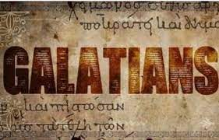

Slide 31



Slide 32
NEXT CLASS – 2 Feb 2022
Book of Galatians
Before next class, read the below chapters in the KJV and in one other versions of the Bible, i.e., NKJV, NRSV, NIV, CEV, etc …
Chapter 1:11 – 24
“Radical Transformation”

Slide 33



the end
Questions
Questions

